Slide 1


SUPER STORE SALES DASHBOARD

Slide 2
OBJECTIVE
To contribute to success of a business by utilizing data analysing techniques, specifically focusing on time series analysis , to provide valuable insights and provide accurate sales forecasting.

Slide 3
DESCRIPTION
The objective can be broken down into the following detailed components :
Dashboard Creation :- Identify the KPIs ,design intuitive and visually appealing dashboard ,add interactive visualisation and filtering capabilities to allow users to explore the data at various level of granularity.
Data Analysis :- Provide valuable insights to business entities regarding the effectiveness of their sales strategies through visualisation in charts.
Sales Forecasting :- Leverage historic data and apply time series analysis to generate sales forecasting for next 15 days.
Actionable Insights and Recommendation :- End goal is to share valuable insights and actionable information that can drive strategic decisions-making and support the superstore’s goals for growth ,efficiency, and customer satisfaction.

Slide 4
Key Performance Indicators (KPIs)
Total Sales
Total Profit
Total Quantity
Discount

Slide 5
VISUALISATIONS
Bar charts: Compare sales by region, product category, or customer segment.
Line charts: Show sales trends over time.
Pie charts: Illustrate market share or product mix.
Gauge: shows meter of sum of sales and value
Slicers: Slicers provide an intuitive way for users to filter data.

Slide 6
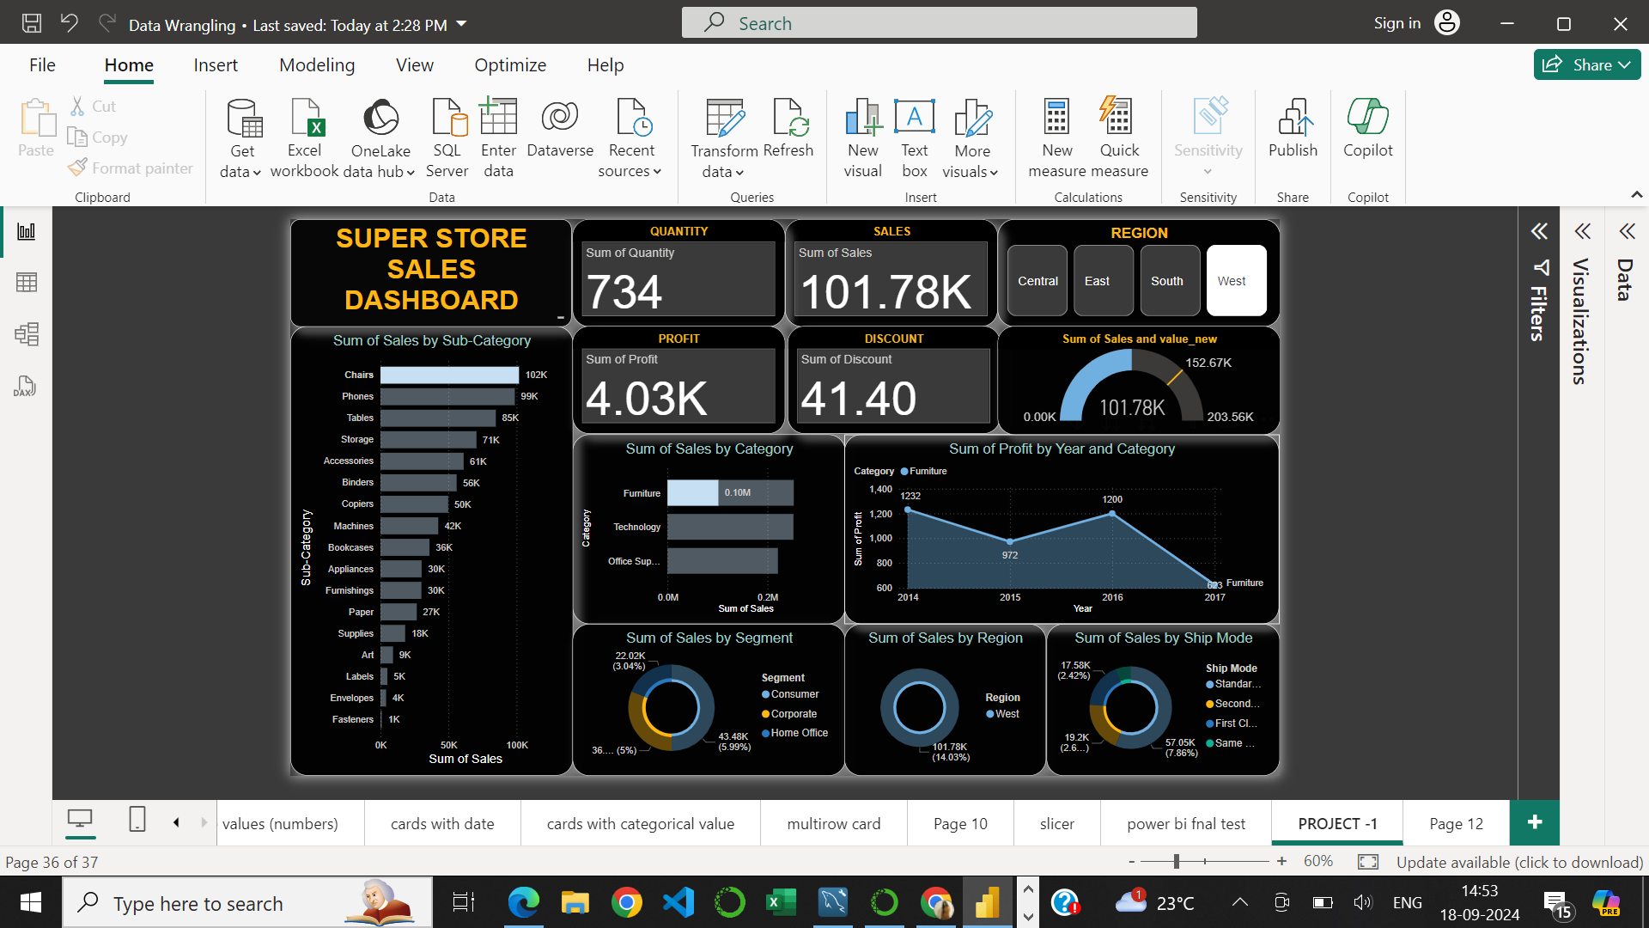
DASHBOARD

Slide 7
INSIGHTS
Here are some common areas to explore:
1. Sales Performance
Overall sales trends: Are sales increasing, decreasing, or remaining stable over time?
Seasonal patterns: Are there noticeable fluctuations in sales during specific seasons or holidays?
Regional variations: Which regions are performing the best and worst in terms of sales?
Product category analysis: Which product categories are driving the most sales and profit?
Customer segmentation: Are there significant differences in sales performance across customer segments

Slide 8
2.Profitability :
Profit margins: How are profit margins trending over time?
Profitable products: Which products are contributing the most to overall profitability?
Cost analysis: Are there opportunities to reduce costs and improve profitability?

Slide 9
RECOMMENDATIONS
Sales Performance
Optimize product mix: Focus on promoting high-margin products and phase out low-performing ones.
Expand into new markets: Identify regions with untapped potential and explore opportunities for growth.
Enhance customer experience: Implement strategies to improve customer satisfaction and loyalty

Slide 10
Profitability
Negotiate better deals with suppliers: Explore opportunities to reduce costs and improve profit margins.
Optimize pricing: Conduct a pricing analysis to ensure that prices are competitive and profitable.
Implement cost-saving measures: Identify areas where costs can be reduced without compromising quality

Slide 11
THANK YOU

